Slide 1

Title of the Project : Robotic Arm
Project Supervisor : Dr. Mercy Paul Selvan
Name of the Student : Chethana. K
Register Number : 40731018

Slide 2
INTRODUCTION
Robotics is now becoming one of the essential elements of restructuring and comprehensive automation in production and non-production sphere.
Current trends of development contribute to the gradual improvement of all its elements based on the need to increase automation, speed, accuracy and safety.
Technical level of robotics increases itself by rapid development of its subsystems and by innovation of its functional elements which participate in its architecture and its morphological processes.
The applications of robotics are having especially demanding requirements for designing these robotic rehabilitation devices.

Slide 3
OBJECTIVES
Robotic arms can be used to automate the process of placing goods or products onto pallets. By automating the process, palletizing becomes more accurate, cost-effective, and predictable.
The use of robotic arms also frees human workers from performing tasks that present a risk of bodily injury.
Army Defense
Chemical Handler
Lifting of very heat/cold objects
Self Defense

Slide 4
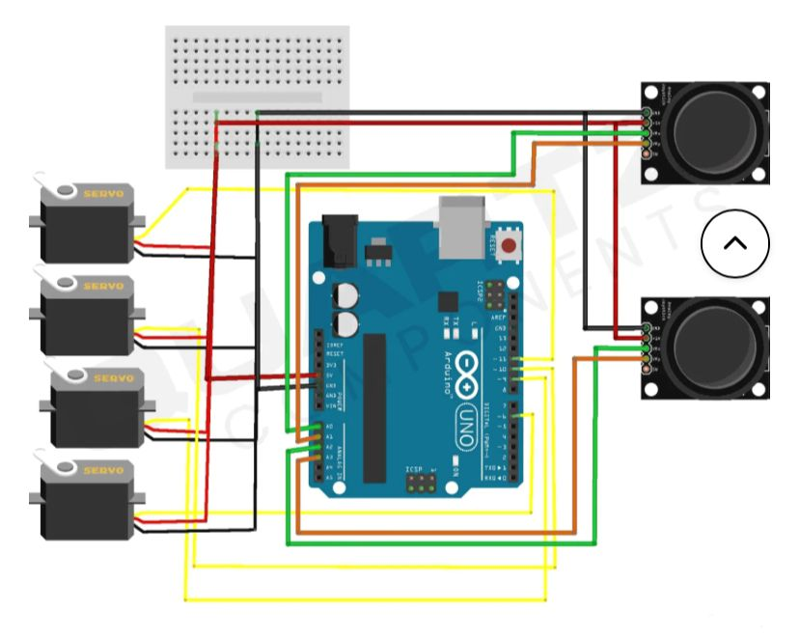
SYSTEM ARCHITECTURE

Slide 5
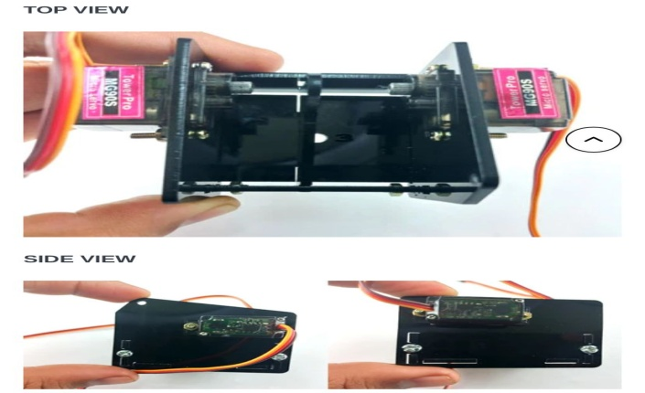
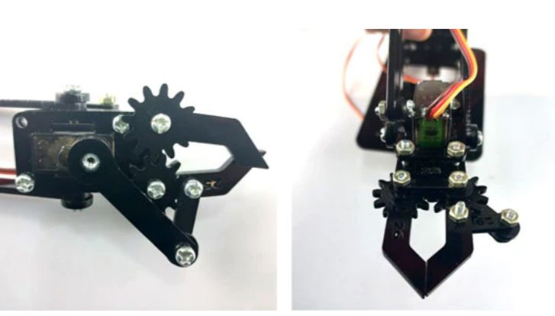
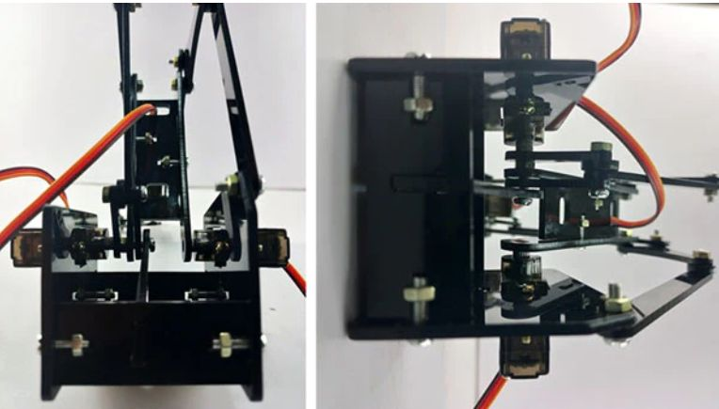
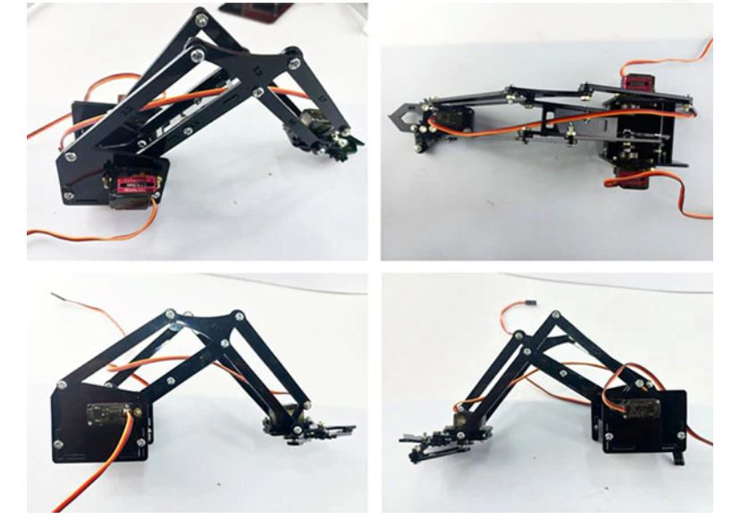
WORK FLOW SNAP

Slide 6
PROJECT IMPLEMENTATION
In reality, there are many different types of end effectors with most of them resembling something less of a hand that you would imagine.
The world of robots manipulating objects is changing each day but there are some end effectors that regularly make appearances on the business end of a robot arm.
It might be more beneficial to look less at how the effector appears and more at how it operates.

Slide 7
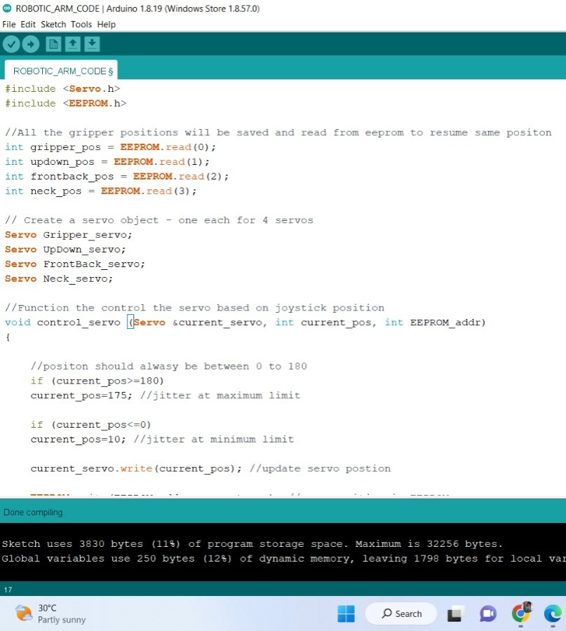
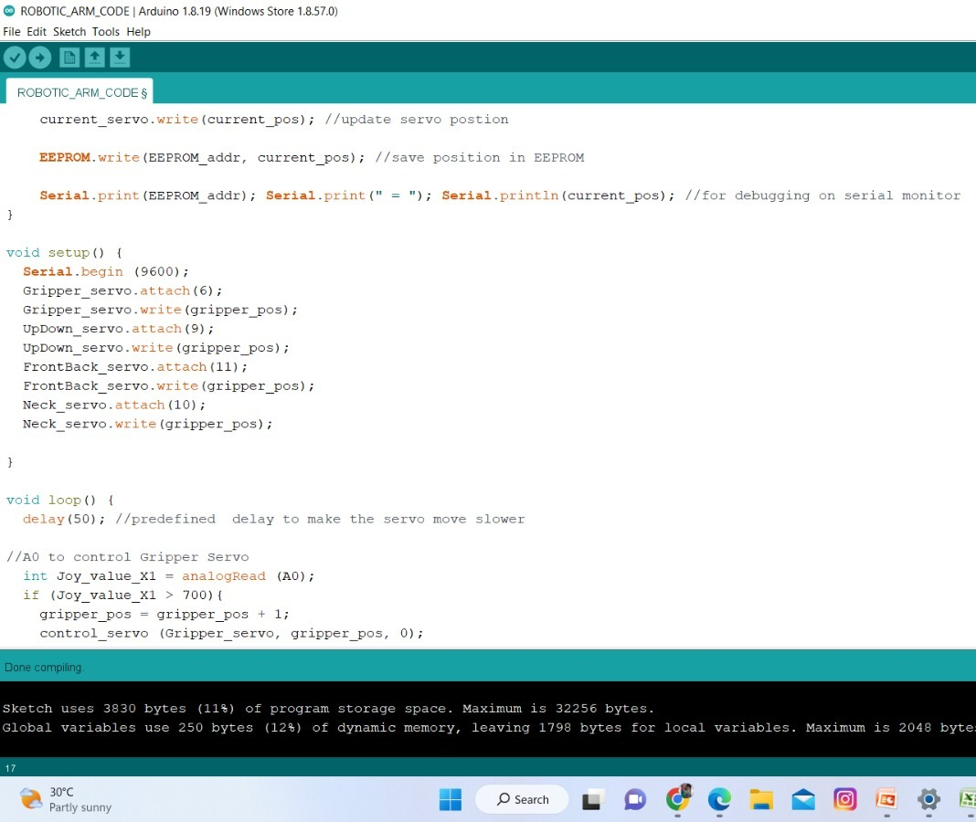
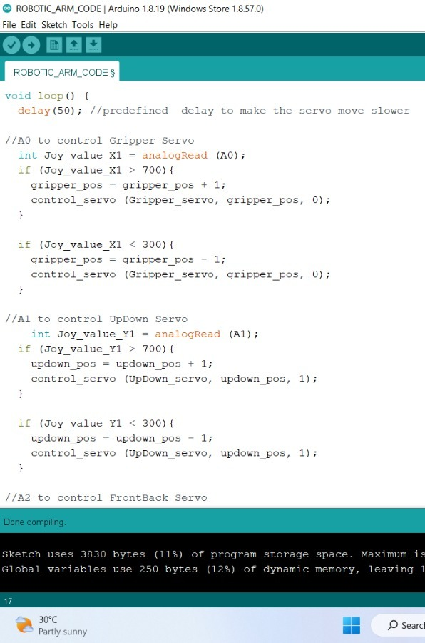
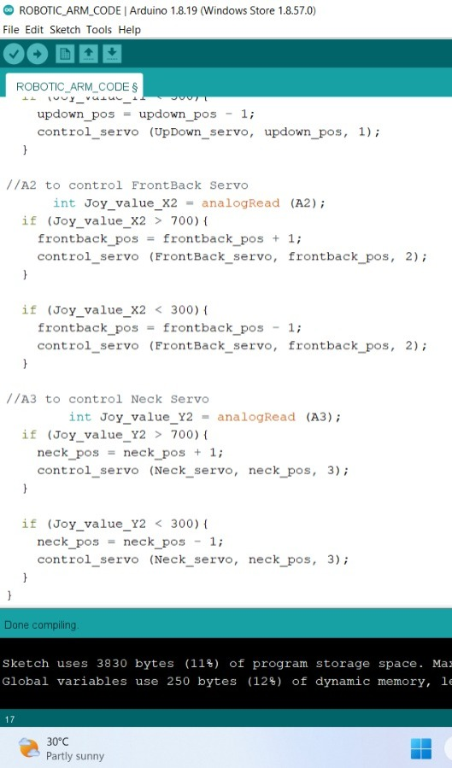
CODE FOR ROBOTIC ARM

Slide 8
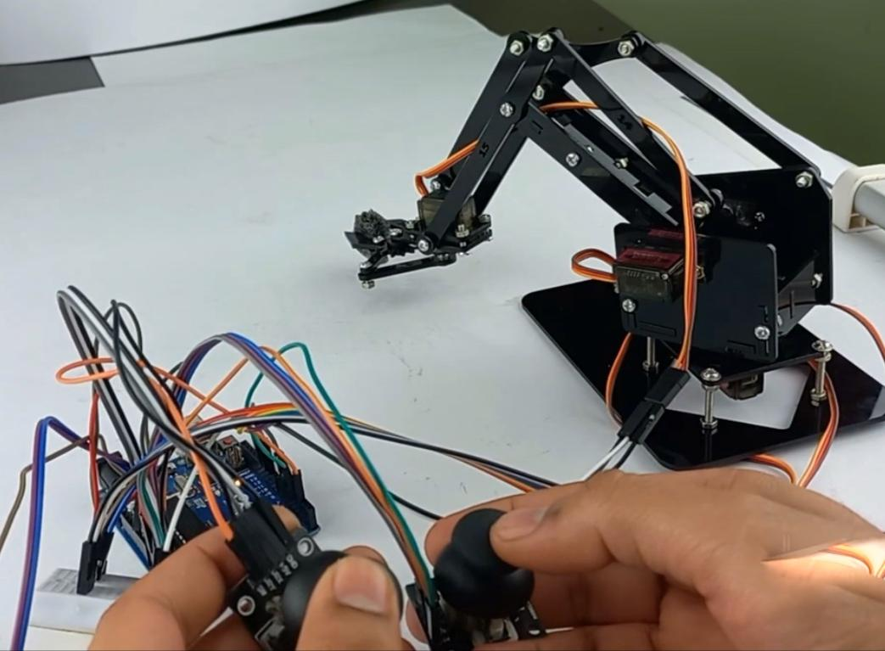
SAMPLE SNAPSHOT

Slide 9
FUTURE WORKS
The robotic arm will next be attached to the robot and worked for advanced technologies.
The fully assembled robot will now be able to act 50% of the human’s activity.

Slide 10
CONCLUSION
A robot that can understand, “Something is in my way, I must move it to complete this task,” then actually perform that action is the idea that robot hand developers are aiming for.
Development will obviously continue in mechanical construction but even the most realistic hand is only as effective as the intelligence driving it.

Slide 11
THANK YOU

